Slide 1





Creating, Building, and Rebuilding Alumni/NESA Committees
Notes:
On behalf of the National Eagle Scout Association, the BSA Alumni Association Committees, and myself, we would like to thank you for taking the time out of your busy Sunday to join us today for this very important webinar.

Slide 2
Why are we here?
  To keep our engaged alumni, and reengage those disengaged
  Remember - you are not alone. We are in this together.
Notes:
Who is our target audience? Who are Scouting’s alumni? Anyone who has been positively impacted by Scouting. We want to hold on to the good people who are currently involved in Scouting, and we want to re-engage those people who have left Scouting.

Slide 3
Agenda
  Top 10 reasons to have an Alumni/NESA committee
  Alumni/NESA committee vision
  Council affiliated groups
  Informational meetings
  Where to find more information
  Final steps
  Q&A
Notes:
This is a webinar, not a Zoom Meeting. By using the webinar format, we are able to include great numbers, and we have more tools at our disposal.
We have disabled the “Chat”, but we have enabled the “Q&A” feature. Throughout the presentation, you have the opportunity to ask questions. There are people who are on the panel who will endeavor to respond to your questions. They will respond to you as an individual or if they feel this is a great question for the entire group to hear the response, they will share their response with everyone. When we get to the end of the presentation, penal will response to the questions verbally.

Slide 4
10 Reasons
  I believe in Scouting
  Scouting was good for me
  I want to support the next generation of Scouts of Scouts and Scouters
  America is and will be better because of Scouting
  I believe in helping others through Scouting
Notes:
Please think about why you continue to support Scouting. Do some or maybe all of these reasons resonate for you?
Why did you join Scouting?
I came in as a Cub or Scout.
My children joined Scouting.
Scouting is the best character-building value-based organization in this country.
I get a kick out of seeing Scouts grow in the program. I feel like I am contributing to making my community, state, and country better.

Slide 5
10 Reasons
6. I want to give something back to Scouting
7. I have skills and expertise that would benefit Scouting
8. I have great Scouting memories
9. Scouting is about giving, not getting
10. There is no better leadership development program for youth than the BSA
Notes:
Ross Not only do I have skills and expertise to share with the next generation, but there are a lot of caring adults who also have skills and abilities that they could share if given the opportunity and guidance.
I have some great memories from my time in Scouting such as participating in four national and one world jamborees.
What are some of your great Scouting stories? Pick three people to share.
One thing I have learned is that Scouting is about Giving not getting. But let’s be honest, I get a lot out of Scouting.
Does anyone disagree with reason number 10?

Slide 6
Alumni/NESA Committee Vision
  Most sessions discuss how the mechanics of pulling committees together - not us!
  We will focus on the vision for the Alumni or NESA Committees
  That vision guides your plans on how to organize your committee
Notes:
We are not going to spend a great deal of time talking about the mechanics of putting together a committee. Instead, we going to focus on the Vision for a committee. Vision drives perception and perception drives action. The vision of what your committee wants to accomplish will guide your committee’s plans, both short and long-term.

Slide 7
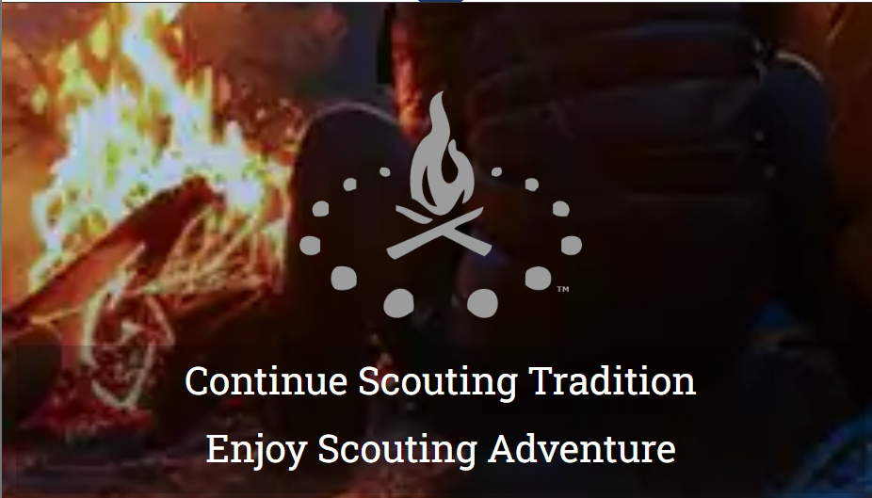
The Alumni Association
  https://scoutingalumni.org/
Notes:
Have all of you gone on to this website?

Slide 8
Every Council is Different
  Each council is different, so each Alumni or NESA committee should be different
  Rather than build a committee and figure out what you are going to do, reverse the process!
Notes:
Every council is different, with its own strengths, weaknesses, and challenges. Based on the strengths, weaknesses, and challenges, each council will develop their plan of action and will structure its committee to act on that plan.

Slide 9
Alumni/NESA Programs
  Programming offered
    Scouting Events
      Alumni or Eagle Scout recognition events
      Support at district and council events
    Service Events
      For Scouting like camp service days
      For the community at large
Notes:
What are some Alumni or Eagle Scout events that Alumni and or NESA Committees could support?
Ask three people.
What are some district and council events that Alumni and or NESA Committees could support?
Ask three people.
What are some service projects that Alumni and or NESA Committees could support?
Ask two people.
Don’t forget all Scouting activities must adhere to all safety rules outlined in “Safe Scouting,” government regulations, guidelines, and all YPT rules.

Slide 10
Alumni/NESA Programs
  Programming offered
    Regular Social Events
      Baseball games
      Open house at camp
      Happy Hour meet and greet events
    Special Events
      Anniversaries
      Reunions
Notes:
What are some social activities that your Alumni and or NESA committee has either sponsored or participated in?
Ask three people.
Share some alumni events, such as Gathering of Eagle (GOE) or Gathering of Alumni (GOA) events.

Slide 11





















Council Alumni Chapters
Notes:
This is a partial list of our Affinity and Affiliate groups. You can start a chapter of one or more of these groups in your own council. For example, you could start an Educators Group that promotes and administers the Fretwell Award. If you are interested in doing this in your own council, please reach out to me and I will get you in contact with Dr. Spencer Long, who charts the National Educators Committee.
Given the fact that our name will be changing to Scouting America, many of these logos will be going through some re-design.

Slide 12
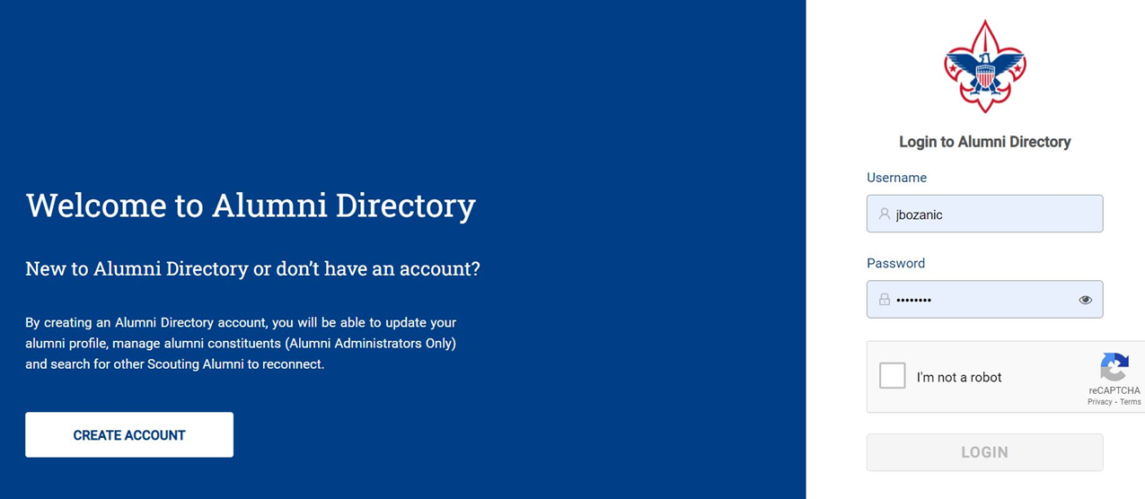
Alumni Portal
  https://directory.scouting.org
Notes:
After one registers, they can view their profiles and see what information has been posted for them.

Slide 13
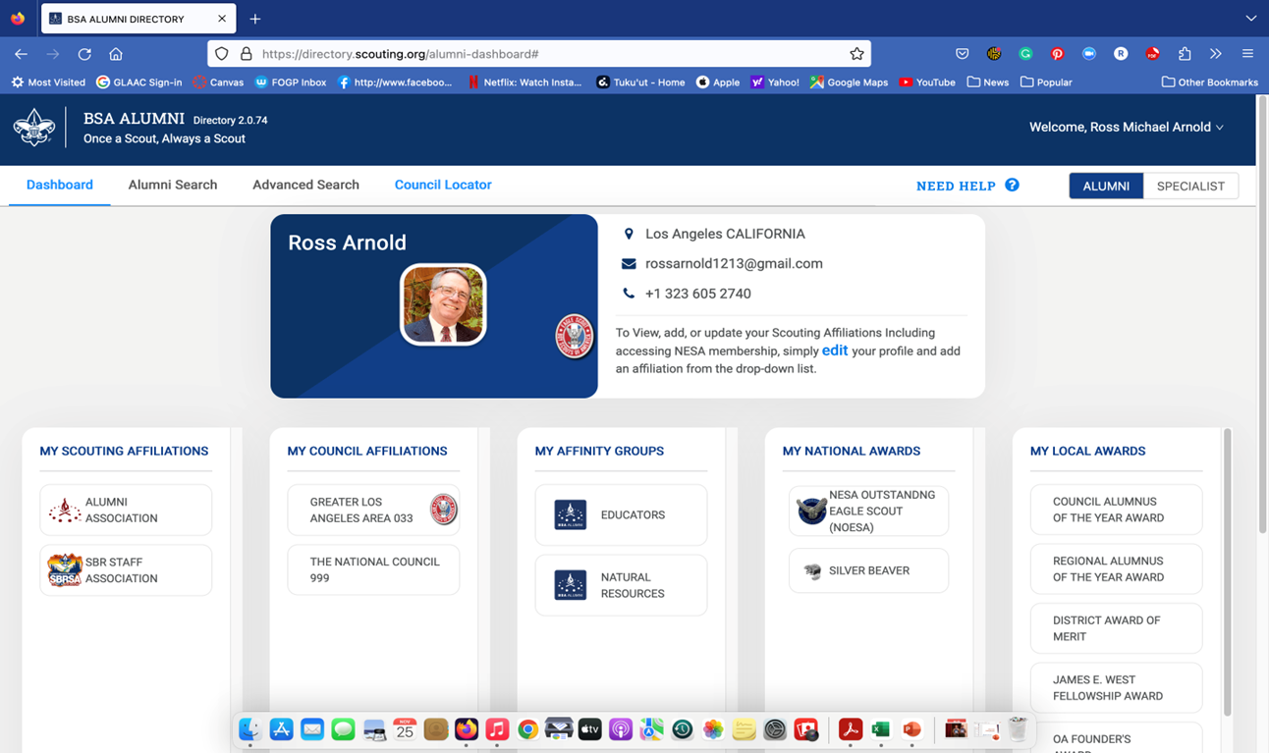
Update Your Profile
Notes:
For some of these categories, it is possible to modify the information. For example, if you add that you are a Life Member of NESA, you could add this information, but if there is a problem because the system does not recognize your membership, you should contact Matthew Wallace at matthew.Wallace@scouting.org There could be a problem with your ID number.
There is a dropdown menu under “My Local Awards” where you can add missing recognitions.
Registering is one of the requirements for the Alumni Award.

Slide 14
Focus on fellowship and socialization
  Quick updates about Scouting at each event
  Alumni events are not financial sponsorship or membership recruitment events
    financial asks should be one-on-one, not a group asks
    membership and volunteer opportunities mentioned, but not forced
Notes:
What does it mean,” leave your checkbook at home?”
During each of our GOEs, I will make a short presentation about what is going on in Scouting and specifically in my council. I also share that I will follow up with an email asking if they would like to get involved. What I don’t want is someone saying they attended one of our events and no one asked them to volunteer. I usually get about 10 percent interested people. You are going to have to help them with where they can volunteer. Scouts have limited understanding of adult positions in Scouting. Most scout’s knowledge of adult positions consists of SMs, ASMs, MB Counselors, and maybe OA Advisors so when they are asked to volunteer in Scouting, these are the positions they think you are asking them to.
Don’t press. Make the point that when they are ready to get reengaged, we will be here waiting for them. Another reason why I send a follow up email is so they have my phone number and email address.

Slide 15
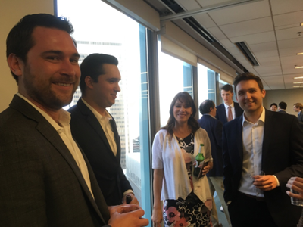
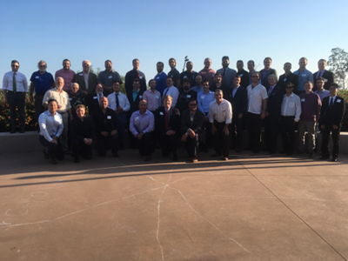
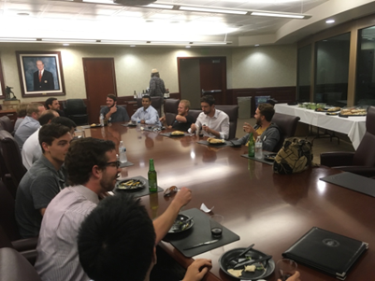
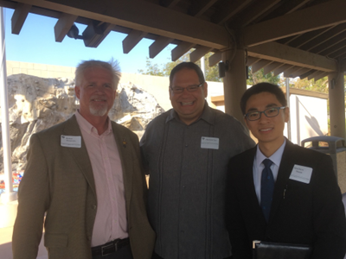
Gathering of Eagle or Alumni
Notes:
These gatherings should focus on socializing and engagement. I would even suggest that when you market these activities, state in the flyer that people leave their wallets at home but bring business cards.
Rely on the members of your committee for venues and suggestions for events.

Slide 16
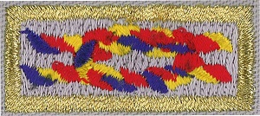
BSA Alumni Award
https://scoutingalumni.org/awards-and-recognition/alumni-award/
Open to Scouting Alumni who promote continued engagement in the BSA
  Application process
  13 of 24 specified tasks in 6 categories
  Comparable to Scouter’s Training Award
  A recognition program to encourage participation and work in council alumni relations programs, including NESA and other affiliate groups
Notes:
A great way of engaging Scouters into participating in alumni activities is to introduce the Alumni Award. Some district committees have suggested that their committee members all earn their awards to support the activities of the district.

Slide 17
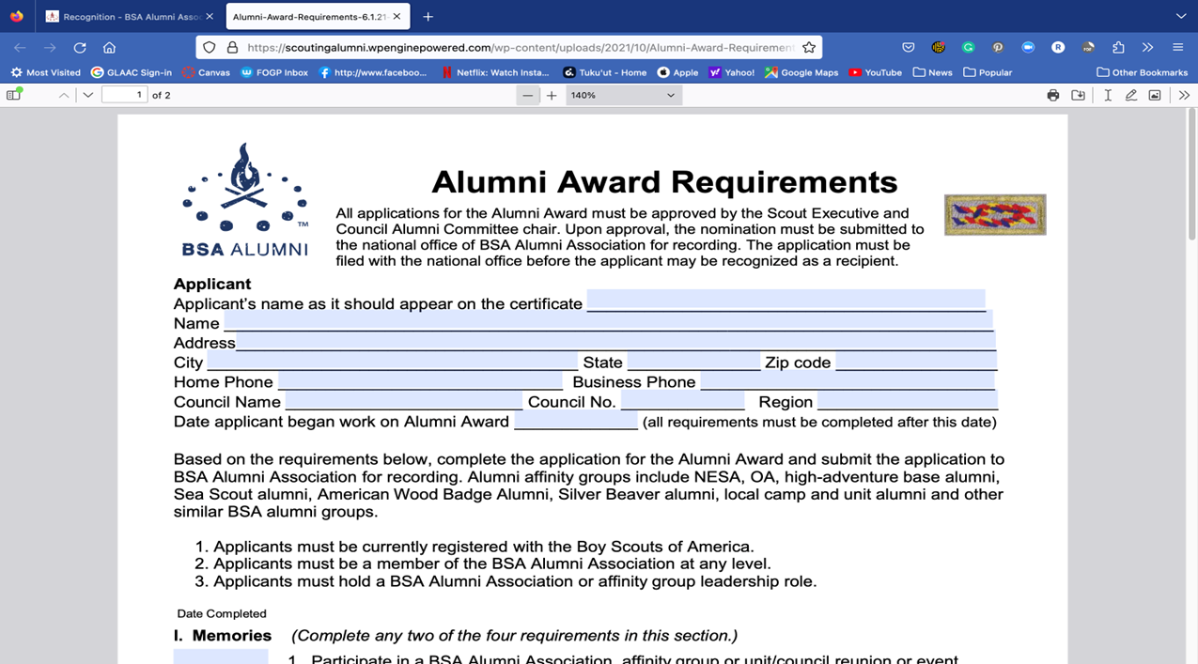
Alumni Award Application
Notes:
This is a copy of the Alumni Award application. Before you begin working on this award, check in with your council’s Alumni Committee Chair. Your council chair is your counselor for this award and will need to sign your completed form and submit it to your Scout Executive for processing. Once you have let your chair know you are working on earning this award, you may use all your Scouting experiences going forward, but you cannot go back.
Make sure you are using the current and correct form. The current form should have a note on the page of Revision of 2021. If the form says “Alumni and Friends” it is an old form.

Slide 18



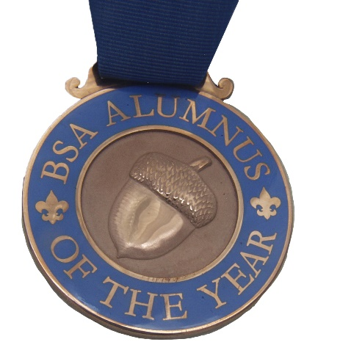
BSA Alumnus of the Year Awards
Council: 1 per council annually (must have Alumni Committee)
Territory: CSTs grouped, 4 annually
National: 1 annually
  nomination process
  comparable to Silver Beaver, Silver Antelope, Silver Buffalo
  recognize BSA alumni who, over a sustained period-of-time, have made significant and long-lasting contributions to the alumni association, communities, and Scouting
Notes:
For a council to present this recognition, a council must have a functioning Alumni Committee with a chair and at least two other members. For all of these recognitions, applications must be submitted to the National Office on or before December 31 each year. There are specific requirements for each of these recognitions.
I need to point out that these awards will probably be going through a process of redesign, given the fact that our name is changing soon to “Scouting American.”
I am not going to go into any depth into the awards I am focusing on because our next webinar will do this on January 12, 2025.

Slide 19
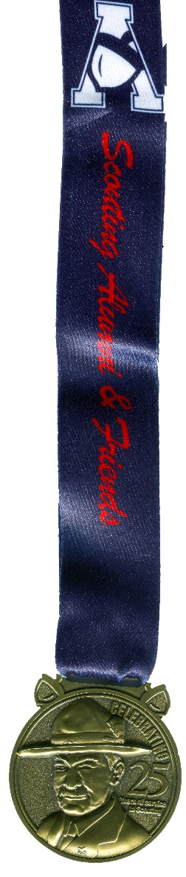
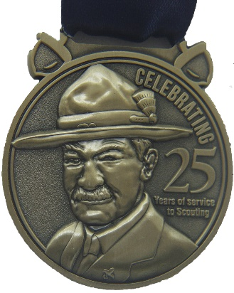
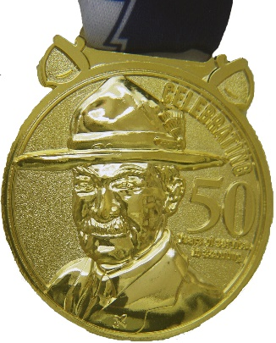
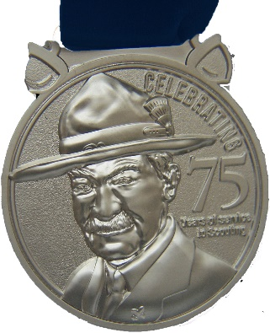
BSA Service Commemoration
25-Year Service (bronze)
50-Year Service (gold)
75-Year Service (silver)
  no formal nomination or application process
  presented by units, districts, councils, or service territories
  recognize BSA alumni who have consistently over their lifetimes provided service to their community, profession, religion, BSA at any level, or youth-serving organization
Notes:
These recognitions are also going through some redesign and are not currently available, but they should be available soon. I have copies of the old certificates that I could send you if you send me an email. If you present a certificate, you could present the medallion after the fact.

Slide 20
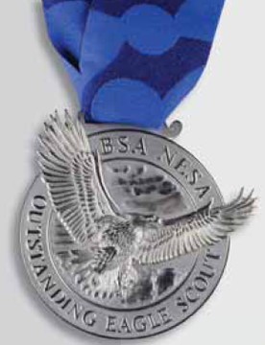

NESA Awards (must have a NESA Committee)
NESA Outstanding Eagle Scout Award (NOESA)
  recognition granted by the local council’s NESA Committee to Eagle Scouts who have demonstrated outstanding achievement at the local, state, or regional level
Glenn A. and Melinda W. Adams National Eagle Scout Service Project of the Year Award (ESSPY)
  recognizes valuable service of an exceptional nature by an Eagle Scout candidate to a religious institution, a school, community, or other entity through the completion of an Eagle Scout project
Notes:
There are two very important recognitions administered by your council’s NESA Committee: the NESA Outstanding Eagle Scout Award (NOESA) and the Glenn A. and Melinda Adams National Eagle Scout Project of the Year Award. To recognize people with these recognitions, your council must have a functioning NESA, which includes a chair and at least two other members. There are specific requirements for each of these awards that must be followed.

Slide 21
7 Steps to Getting Started
  Be knowledgeable and understand the Alumni or NESA program
  Take the BSA Alumni AA online training through Scouting U (My.Scouting.org)
  Obtain permission - talk with the Scout Executive and the Council President about forming the committee(s)
  Get help - find others who can assist you
  Create a plan for the next year - reconnection, communication and service
  Meet with Council Key - 3 to discuss how the Alumni/NESA committee fits in the council’s Strategic Plan
  Start by doing something visible and build from there
Notes:
Lay the foundation for a strong committee by working with your council Key 3. You need to be able to answer the question, how does this committee fit in and support the council’s program?

Slide 22
Next Steps
Once you have a vision and some proposed goals for what your committee is going to do, recruit the committee. You need at least three people.
Revisit this process regularly to update mission, purpose, programming, and membership.
Notes:
In recruiting your committee, focus on Scouters who you have worked with in the past. Look for doers who could be future leaders of this committee.
In putting together your plan of action, focus on three areas: reconnection, communications, and service.
Start small with a successful event and build from there.

Slide 23
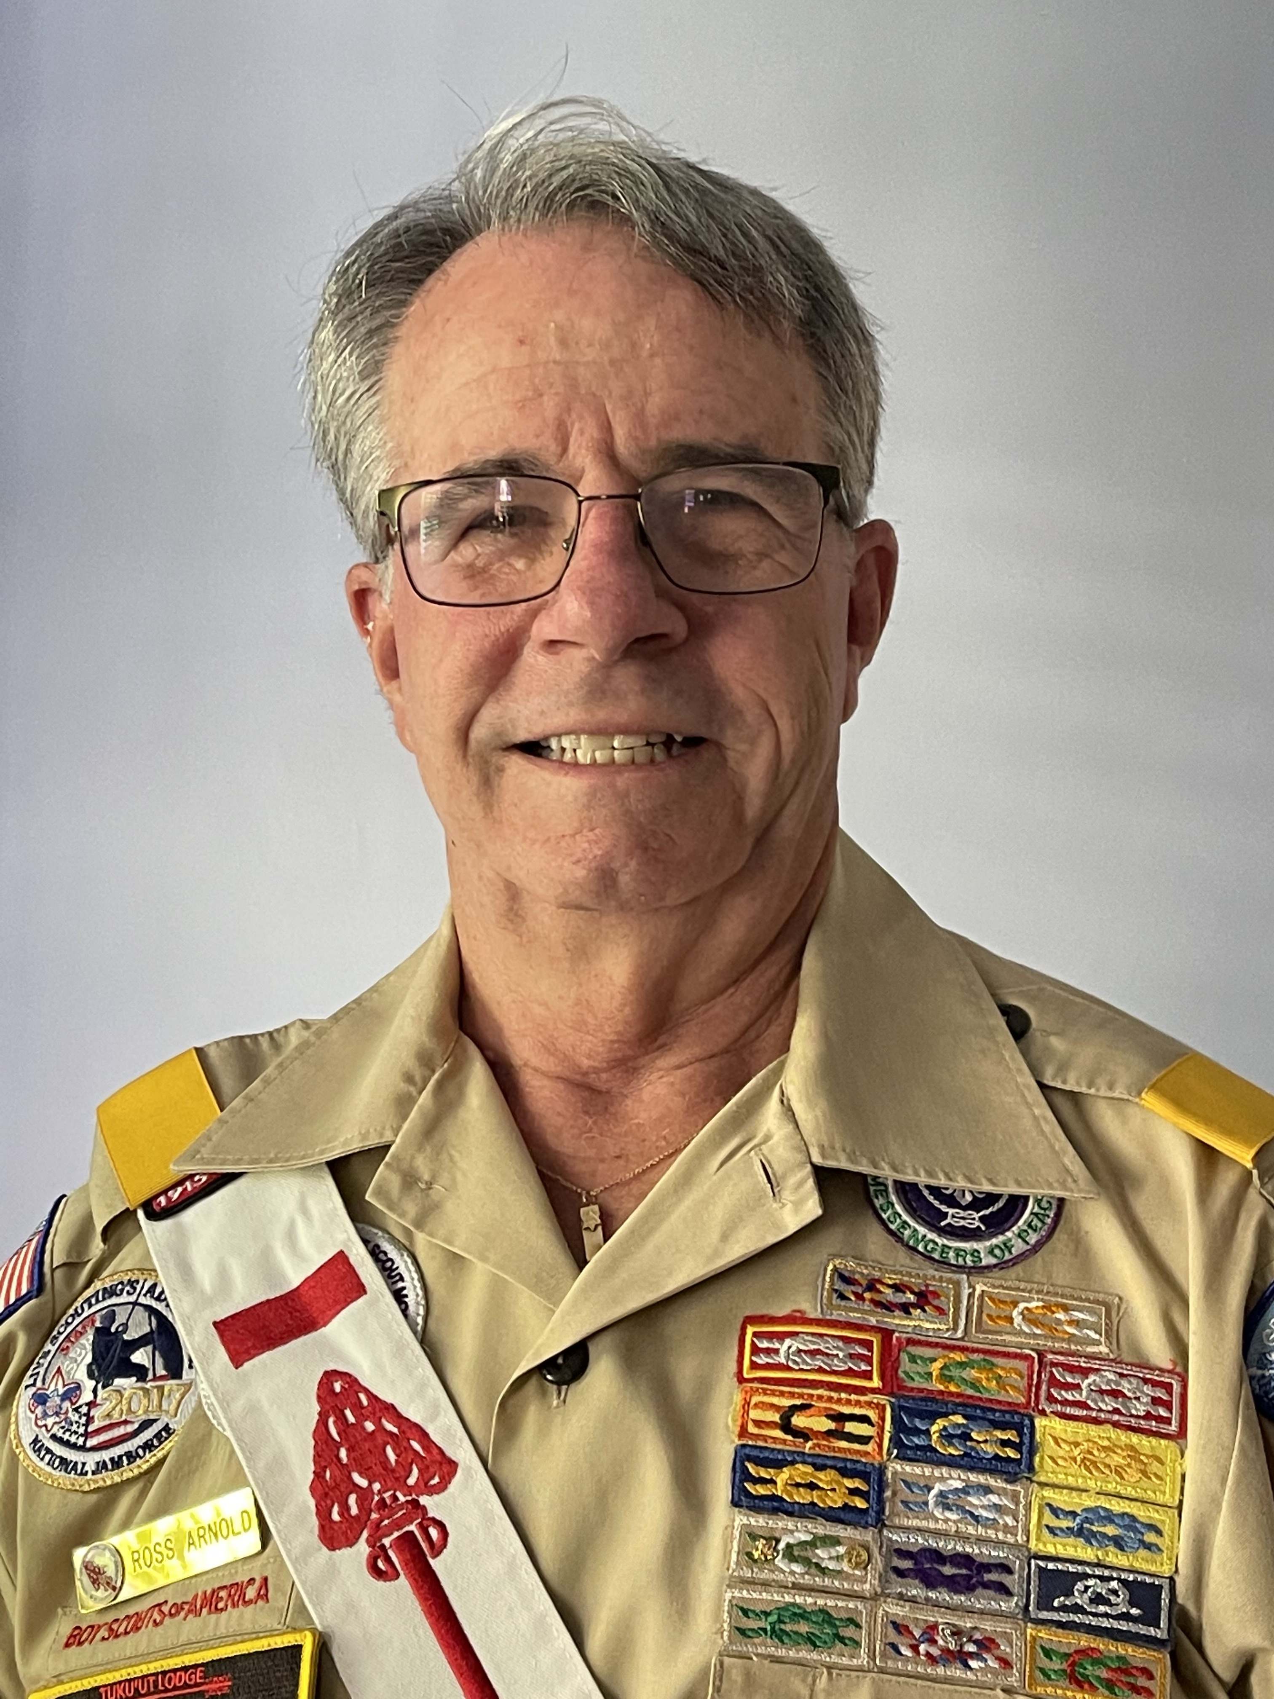
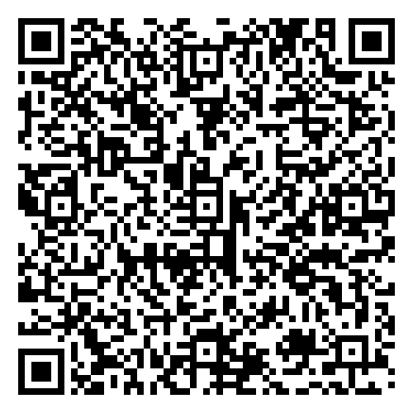
Questions?
For more information:
Ross Arnold Contact:
rossarnold1213@gmail.com
(323) 605-2740
Visit us at: scoutingalumni.org and nesa.org
To help us improve these webinars, please complete this survey.
Notes:
Jeff A minimum committee is three people.

