Slide 1
Developing a Camp Alumni Reunion
February 2, 2025
Notes:
Welcome to the February webinar for Scouting Alumni – this session “Developing a Camp Alumni Reunion” will help Council Alumni Committees understand the value of creating a camp alumni association and having a camp reunion to reengage former camp participants.
Today webinar will be conducted by Bill Litton and Anthony Kenney from the Scouting Alumni National Association.

Slide 2
Who Are Scouting Alumni?
“Scouting America defines Scouting Alumni as anyone who has ever been personally impacted by Scouting!”
Notes:
Bill – What is Scouting Alumni “Any that has been impacted by our Scouting Programs – youth, adults, parents, etc.” This is an untapped resources for councils to use for resource and manpower support for their camp properties. SMEs that could help with engineering reviews – who can use their skills for the improvement of a camp. But the first step is to identify these individuals and invite them back to the council camps.

Slide 3
Why Are Scouting Alumni Important?
Simply put, there are no better “ambassadors” for the Scouting program than Scouting Alumni.
Notes:
These Scouting Alumni can be a force multiplier for the camp properties but also can help promote the value and importance of Scouting in the community. This group knows the value firsthand how their experiences at a council camp helped to shaped them today.

Slide 4
Purpose & Locations
What is the purpose of these alumni reunions?
Where are Alumni Reunions Held?
To reconnect – Individuals that has been involved
To network – Promote camaraderie amongst members
To support – through events and activities
At local scout camp
A public venue such as
Community Park
Civic Center
Public Venue
Notes:
Bill – what are the purposes for a Council Alumni Committee to develop a Camp Reunion program:
To reconnect – to find and bring back those individuals that have been involved with camp programs in the past. They truly understand the value the camp and programs.
To network – To allow past members to build past friendship and new ones on unified mission
To Support – the group will help provide guidance and manpower for camp programs and developments
Where – these can be held at local council camps, or at local sites (such as community park, civic center, public venue) – Easier access to help bring these individuals back to assist with our local council camp programs.

Slide 5
Alumni Reunion Resources
Website Resources (ScoutingAlumni.org)
Scouting Alumni Reunion Planning Guide
Camp Alumni Association Toolkit
Notes:
Anthony and Bill – Discuss the resources available to council alumni to support developing camp reunion programs
*Scouting Alumni Website (National) - several council camps have good examples as well of their camp association programs including their camp reunion events
*Scouting Alumni Reunion Planning Guide
*Camp Alumni Association Toolkit

Slide 6
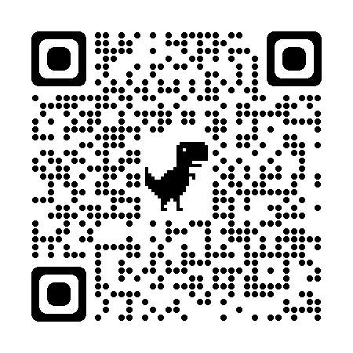
ScoutingAlumni.org
Notes:
Anthony – On this slide you can see the Scouting Alumni website. This is one of the best tools to find information about the Alumni Program.
The QR Code on the side will take you straight to the website.
The website has information on how to get involved with the Alumni Program
Under the get involved tab there is a link/tab called Camp Alumni Associations; this has a list of know Camp Alumni Associations. If you notice that your camp Alumni Association is not list, please click the suggest an update to the list below box.
Also, there is a link to the Camp Alumni Association Toolkit at the bottom of the page.
Under the Resources Tab, you can see the tab for Scouting Alumni Reunion Planning Guide

Slide 7
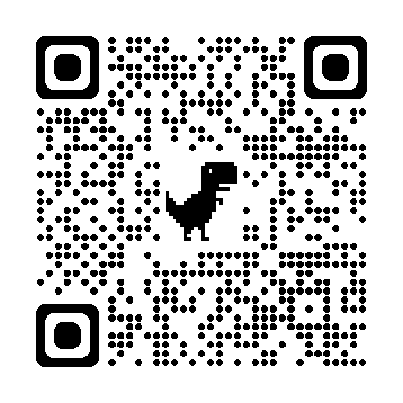
Scouting Alumni Planning Process
Identify Committee
Appoint a Chair
Expand Committee
Set Goals
Identify Audience
Location
Determine Date
Budget
Timeline
Service
Contingencies
Notes:
Anthony – Scouting Alumni Planning Process – Note QR code to the Scouting Alumni Reunion Planning Guide.
Identify your committee: For a reunion, start by identifying three or four core people for your reunion committee who are organized, good communicators, and are familiar names among your intended Scouting alumni audience. These core volunteers will serve as the nucleus of a successful reunion; however, delivering on all the operational tasks will expand from here. This core group will be the drivers who will keep the momentum going forward.
Appoint a Chair: Among the three or four core volunteers on the reunion committee, the Committee Chair, or Co-Chair, must be someone who possess the following characteristics: • Maintains respect among the other core committee members • Well known to a good number of your intended Scouting alumni audience • Exhibits good communication skills • Demonstrates organization, knows how to delegate, and ensures task completion by deadlines • Proven leader through planning sessions • Not shy about making tough calls when the committee is not unanimous • Collaborative with Council leadership
Expand the Committee – Adding idea people who are willing to take on specific Functional Tasks for the Reunion – Examples are Communications (Before, During, and After Event, a very important piece to ensure your event is attended and know about), Registration/Check-In, Health/Safety & Disabilities, Activities Planning, Memorabilia ( Name Tags, Shirts, Patches, etc.), Food Services/Hospitality ( the simpler the meal the better, unless a banquet), Sleeping Accommodations ( if needed)
Set Goals: Identifying and stating your reunion goals and outcomes is the essential starting point in planning a successful and impactful Scouting Alumni Reunion. Here are some considerations to help your committee define those goals and intended outcomes: • Duration – Will the reunion be for an entire weekend, a single day, or a few hours? • Attendance – Are you focusing on all Scouting alumni, specific groups, certain years, etc.? Will you set a cap for the number of attendees for the event? • Program – What program offerings will be included? Will there be a campfire to culminate the reunion? Will there be a remembrance service for those who have passed away? Any special recognitions to be made? • Outcomes – Do you want to hold reunions regularly and recruit volunteers for planning teams? Are you seeking fundraising goals for a specific project or initiative? Will you be able to update contact information and increase communication effectiveness?
Identify Target Audience - Considerations: • Will this reunion be for a specific alumni organization (e.g., Camp/Camp Staff, NESA, Order of the Arrow Lodge, Wood Badge, etc.?) • Will this reunion be for a specific anniversary (e.g., Council, Camp, OA Lodge, Troop, etc.?) • Will this reunion be open to all Scouting alumni?
Location: Another important aspect to your initial planning is consideration of the reunion location. A successful reunion can be held at the local scout camp, community park, civic center, or public venue (e.g., sports grill, brewery). Considerations: • How many do you plan to invite? • What yield do you expect to attend the event? • Will the reunion be a short event (e.g., 2-3 hours) or a long event (e.g., full day, overnight, weekend)? • Do you have any venue connections through members of the planning committee? • Will the reunion need outdoor space for activities and games?
Determine your Date: Considerations: • What time of year is ideal for the reunion? • Are there weather or seasonal impacts to consider? • Are you going to host the reunion in conjunction with another event/program like summer camp or an Order of the Arrow event? • Would a weekday evening or weekend date be best for your audience?
Budget: A budget is an essential element to any Scouting Alumni event, especially a reunion. Budgets can be simple, but helpful by providing the boundaries for what is possible versus what is outside of reach. Revenues A list of potential revenues is provided below while not exhaustive. Additional information about key revenues follows. • Registration Fees • Contributions/Sponsors • Memorabilia Sales (e.g., patches, t-shirts, hats, trading post items) – Expenses
Timeline – Taking more about on the next slide
Service: Examples: • Can food drive • Trail clean-up • Camp facilities improvement project • Meal packaging • Scouting clothing closet donations
Contingency Plans: No matter the amount of planning that goes into organizing a Scouting Alumni Reunion, issues may arise that could change, postpone, or even cancel those plans. Issues such as inclement weather, widespread illness, and even disruptions in the delivery of food and equipment are a few examples of issues that organizers should have a “Plan B” for.

Slide 8
Reverse Timeline Development
Notes:
Anthony – Reverse Timeline Development ( Note the Example of the Save the Date for Camp McKee Alumni Association)
Timeline Development: Regardless of its size and scope, it is certainly possible to have a successful alumni reunion event with only a few months of preparation. However, many of the expected participants at most events will need more than a few months of notice to consider travel arrangements, school activities, sports schedules, and vacation plans. Thus, the development of the reunion’s timeline is crucial during the “initial” stages of the planning. Also, you should consider what programming will be included in the reunion as well. Whether you are planning a reunion lasting a couple of hours, a full day, or a full weekend, the schedule is important for both planning purposes and for potential attendees.
Communication Timeline: Depending on the reunion you are planning, the communication timeline may appear different. If you have a well-established alumni community with regular programming, the timeline could be much shorter. If this is your first event and there are few immediate and reliable alumni, then you may have a longer timeline. Use the backdating concept to map out your own communication timeline by starting with the event and working backwards to the present moment. Here is a proposed communication timeline for a larger reunion event with some established communication channels:
• Pre-Work (6-8 months in advance) o Gather your sources for Scouting alumni contact information. o Consider what communication mediums you have access to and will be effective. o Determine how much or how little communication do you plan to do. o Evaluate what skills your planning committee has for creating, designing, and publishing the reunion event.
• Initial Invitation (4-6 months from event) o Save the Date announcement, at a minimum o Email Invite o Postal Mail Invite [postcard, formal letter, invitation packet] o Social Media event and/or post(s) by individuals on pages and in groups o Once organizers are confident that the essential elements of the reunion are confirmed (e.g., dates, times, location, registration, costs, etc.), it is time to start advertising the event. The announcement should be as far in advance of the reunion date as possible and be distributed across a variety of media - websites, social media venues, newsletter/eBlast, etc.
• Reminder (1-4 months from event) o All mediums o Open Registration, if possible, o Personal outreach is effective, such as text messages or phone calls by members of the planning committee or influential stakeholders.
• Last Chance (1-2 weeks from registration deadline) o All mediums o A good tip is to reach out to those who are registered with a request to invite 2-3 additional friends within their circles to grow your registration.
• Event Details (sent 3-7 days out before the event) o Be sure to include all details ▪ Arrival date/time ▪ Parking details ▪ Where to check-in/register on-site ▪ Health and safety information ▪ Weather forecast ▪ Important contact numbers ▪ What to pack/bring
• Post-Event Follow-Up (within 48 hours after the event) o Email attendees of the event ▪ Post-event survey ▪ Thank you for attending ▪ Link to photo repository for event (or link to collect photos) ▪ Save the date for the next event, if applicable

Slide 9
To help us improve these webinars, please complete this survey.
Visit us at:
scoutingalumni.org
and
nesa.org

Slide 10
Questions?
Bill Litton
bsaalumnisr@gmail.com | (407) 988-4445
Anthony Kenney
anthonybkenney@gmail.com | (859) 806-9163

Slide 11
Upcoming Webinars…
Our next webinar will take place on Sunday, April 6, 2025, at 3:00 PM Pacific, 4:00 PM Mountain, 5:00 PM Central, and 6:00 PM Eastern.
The Topic will be “Why Councils Should Strengthen Their Alumni Relationships.”

