Slide 1
Alumni Communities “Scouting’s Untapped Potential”
Bradley G. Taylor, National Lead
Alumni Communities Subcommittee
bgtaylor1991@gmail.com
(336) 408-8501
Timothy C. Brown, Vice Chair
Alumni Relations & Council Support
bsaalumnicommittee@gmail.com
(859) 421-5985

Slide 2
Objectives
Learn about Scouting Alumni and the resources available to support your alumni engagement efforts.
Understand Alumni Communities and the various types, including groups to connect with locally and nationally.
Access alumni-centric resources for your use and benefit.
Understand how to connect with and support alumni communities as a key to growing our shared impact.
Connect within the Scouting Alumni community, specifically as an Alumni Ambassador, to network and share ideas.

Slide 3
The Current Scouting Alumni Landscape
Est. 30+ million living alumni…
Most have been absent from Scouting for many years
Many are unaware they are Scouting Alumni
Most are difficult to find as their alumni data is incomplete
There can be many generational differences
Notes:
Despite a vast alumni base, active engagement remains low. Addressing communication gaps and data inconsistencies is crucial.

Slide 4
“Top of the Funnel”
We are aiming to create broad awareness and outreach to our 30+ million alumni in hopes of connecting them back to the Scouting program via an Affiliate Group, an Affinity Group, a Civic and Community Partner Organization, a local Scouting America Council, or a council’s camp alumni association.
Scouting Alumni
Councils and Community Groups
Notes:
Our alumni encompass a diverse group, from former youth members to dedicated volunteers and supporters. Recognizing this diversity is key to effective engagement. We define an alum as anyone positively impacted by Scouting.

Slide 5
Scouting America
Scouting Alumni
Alumni Relations & Council Support Committee
Alumni Communities
Affiliate Groups
Affinity Groups
Civic and Community Partners
Camp Alumni Associations
Local Councils
College Alumni (Coming Soon)
Notes:
Our alumni encompass a diverse group, from former youth members to dedicated volunteers and supporters. Recognizing this diversity is key to effective engagement. We define an alum as anyone positively impacted by Scouting.

Slide 6
What are Alumni Communities?
“Connection Point”
Alumni Communities are alumni-centric groups whose members share common interests, similar experiences, and familiar locations…all of which offer alumni the opportunity to find something meaningful to them.
Notes:
Our alumni encompass a diverse group, from former youth members to dedicated volunteers and supporters. Recognizing this diversity is key to effective engagement. We define an alum as anyone positively impacted by Scouting.

Slide 8
Alumni Communities
VISION
A vibrant, engaged alumni community committed to advancing Scouting’s mission and life-changing programs.
MISSION
To gather every eligible alum to foster a lasting community that celebrates and perpetuates the life-changing experiences and values of Scouting, as embodied in the Scout Oath and Law.

Slide 9
TARGET AUDIENCE
ENGAGED
Currently registered
Subscriber
Volunteer
Ambassador
Advocate
Donor
DISENGAGED
NOT Currently registered likely for a very long time…
Unaware of the program status, volunteer opportunities, or connection points
Potential…
Volunteer
Ambassador
Advocate

Slide 11
Searching for Scouting Alumni
Identify Locally Available Alumni
Personal Networks
LinkedIn
Local Scout Council
Community Groups and Organizations (i.e., Rotary, Kiwanis, Civic Clubs, Young Professionals, Chambers, etc.)
Conduct Effective Outreach → INVITE, then ENGAGE! (don’t ask anything at first)
Ultimately Realize Consistent Retention
Notes:
Our alumni encompass a diverse group, from former youth members to dedicated volunteers and supporters. Recognizing this diversity is key to effective engagement. We define an alum as anyone positively impacted by Scouting.

Slide 12
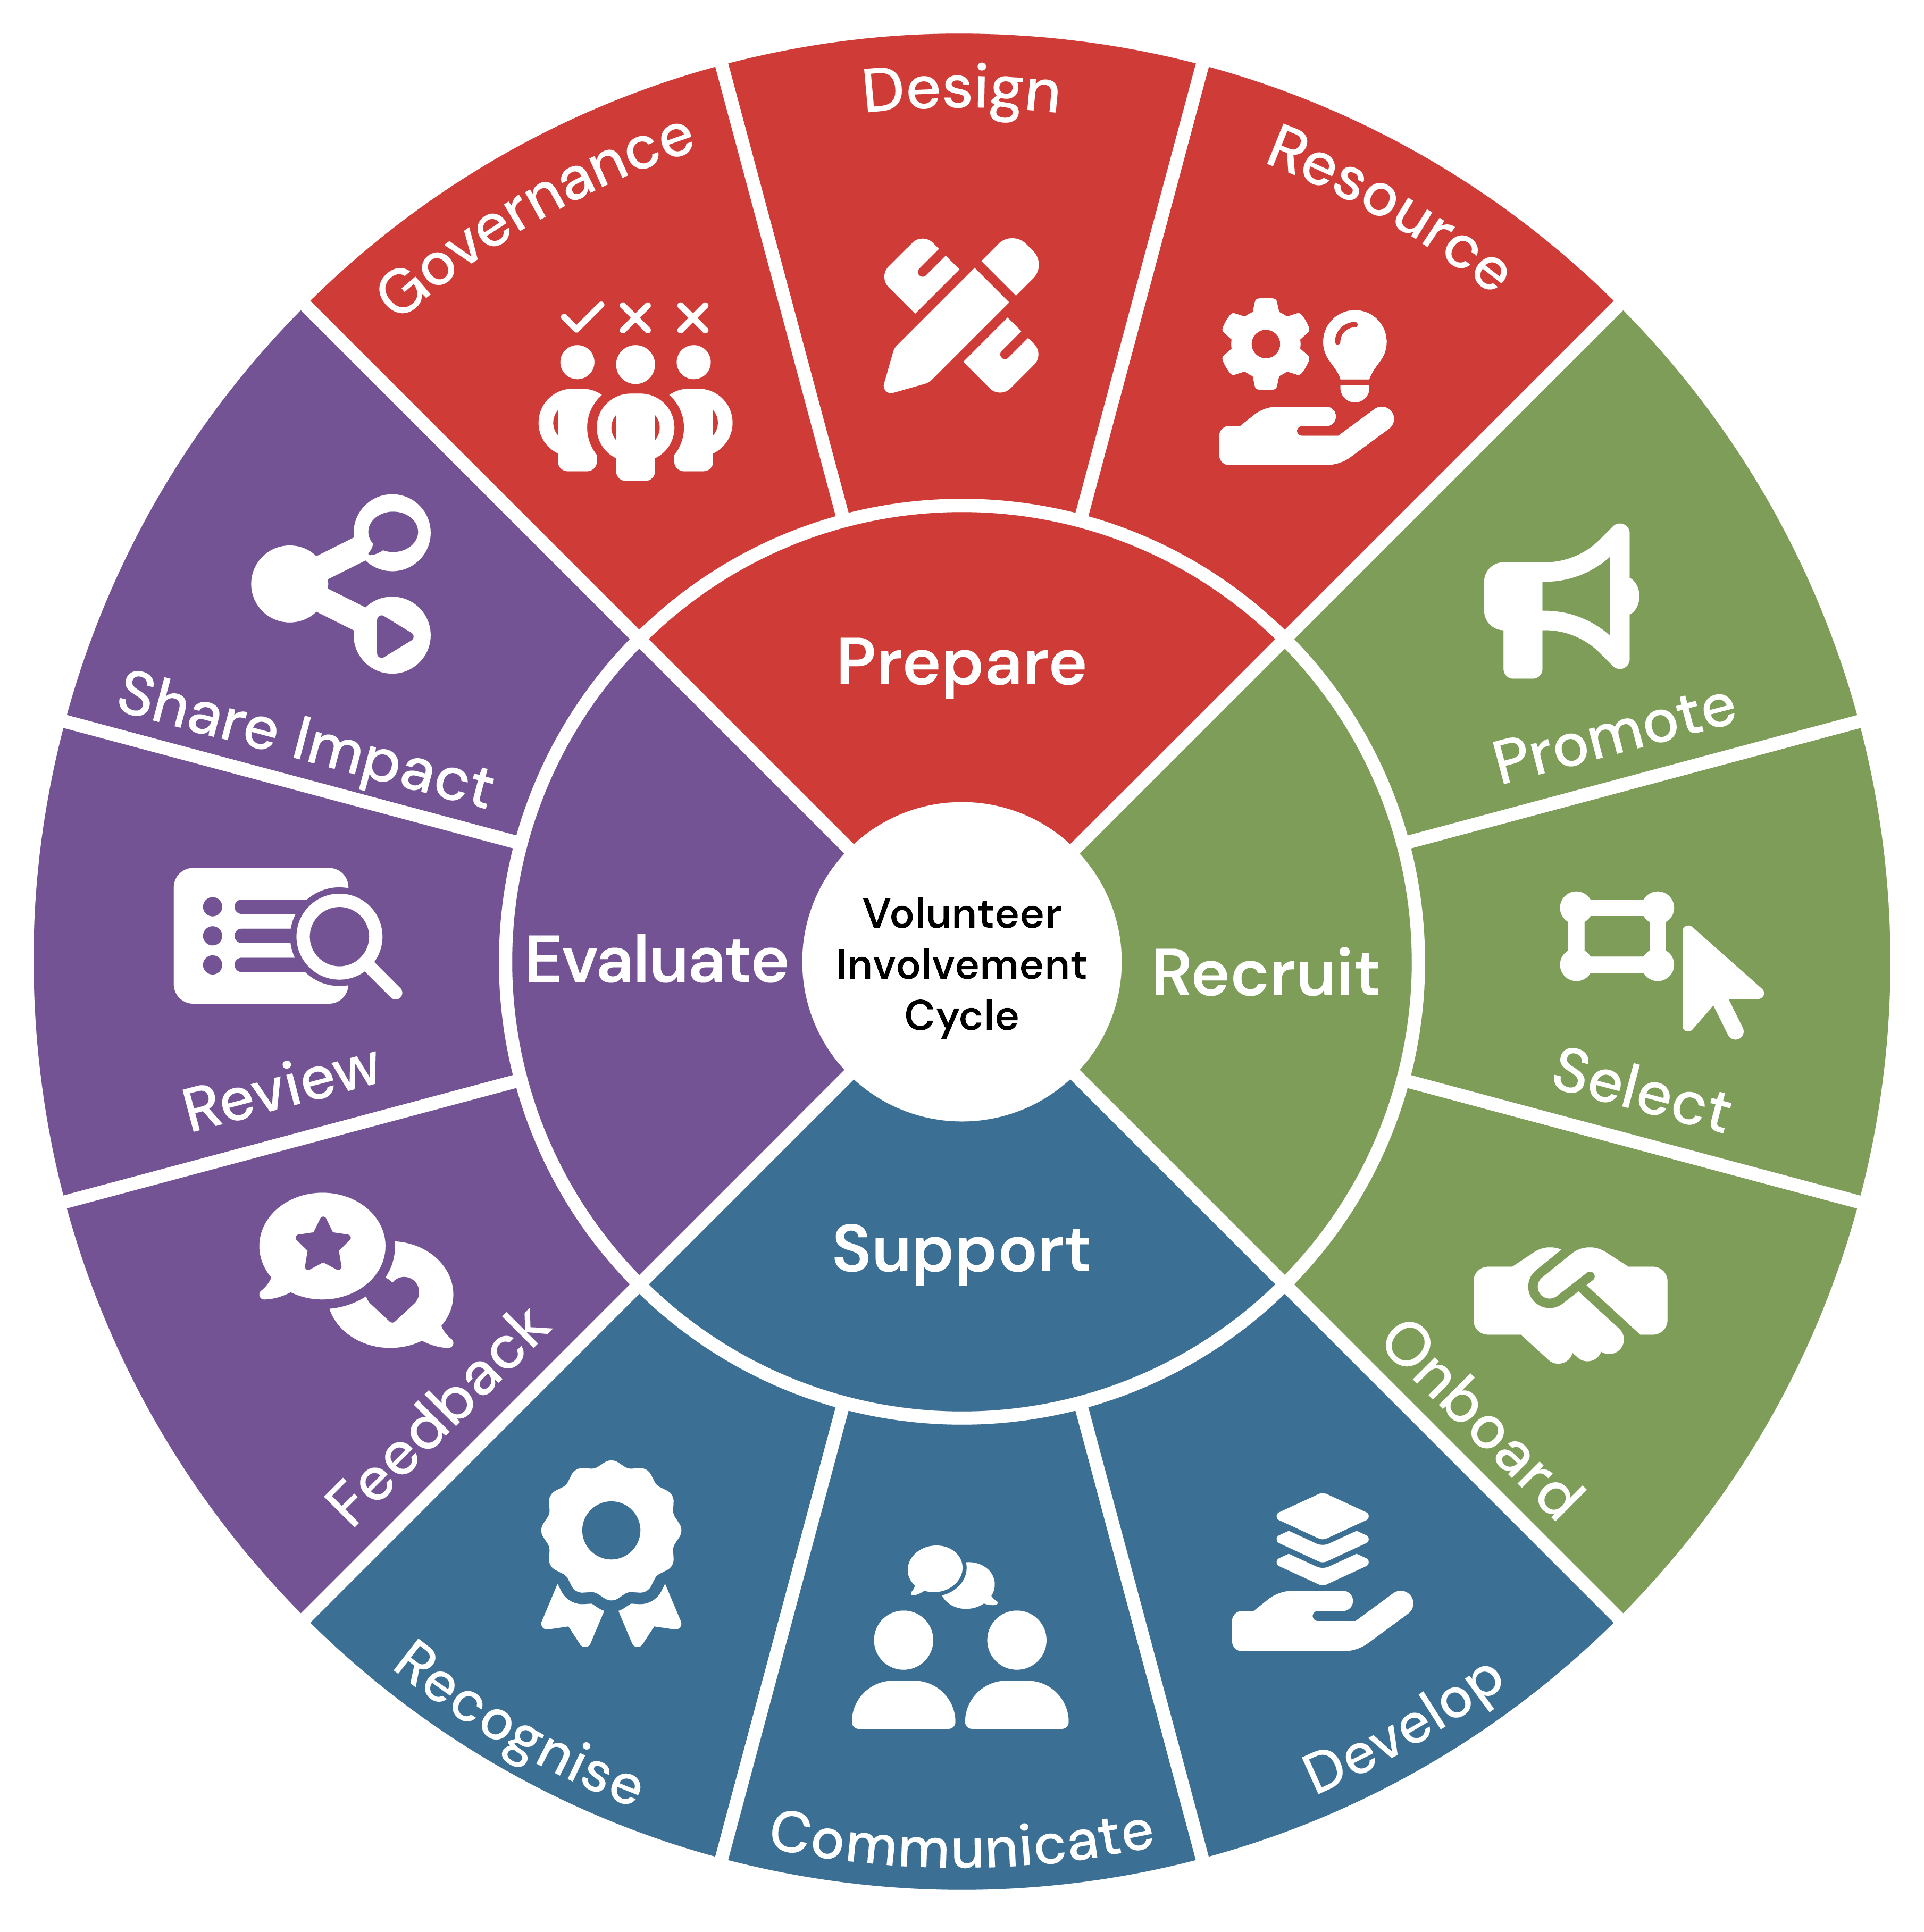
Where can Alumni ADD Value?
Scouting Alumni can add value to the Scouting program on many levels. However, it’s locally that has the “Greatest Engagement Potential.”
Council Engagement i.e., board, committees
District Engagement i.e., committees, commissioners, MB counselors
Unit Engagement i.e., committees, family Scouting, CORs
Group Engagement i.e., local alumni committee, ALUMNI COMMUNITIES
Notes:
Our alumni encompass a diverse group, from former youth members to dedicated volunteers and supporters. Recognizing this diversity is key to effective engagement. We define an alum as anyone positively impacted by Scouting.

Slide 13
National Affiliate Groups
National Affinity Groups
Civic & Community Partners
Council Camp Alumni Assoc.
College & University Chapters
Notes:
Despite a vast alumni base, active engagement remains low. Addressing communication gaps and data inconsistencies is crucial.

Slide 14
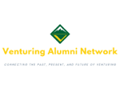
National Affiliate Groups
National Affiliate Groups are alumni communities internal to the Scouting program, which bring together those individuals who share certain Scouting experiences such as high adventure, youth leadership, awards and recognitions, rank achievement, and programmatic involvement.
Charles L. Sommers
Alumni Association
Notes:
Implementing these tactics can significantly enhance alumni participation and connection.

Slide 15
National Affinity Groups
National Affinity Groups are alumni communities whose members share a common interest in select vocations, avocations, or career paths, and are brought together through their previous or current participation in Scouting and their collective desire to further the Scouting program.
Notes:
Implementing these tactics can significantly enhance alumni participation and connection.

Slide 16
Civic & Community Partners
Civic & Community Partners are external organizations whose partnership helps to advance Scouting’s mission through their organizational-specific programming, and membership engagement.
Notes:
Implementing these tactics can significantly enhance alumni participation and connection.

Slide 17
Council Camp Alumni Associations
Council Camp Alumni Associations welcome camp participants and staff back to the campfire to provide spirit, service, and support to the local Scout camp and its related outdoor programs, and to help sustain and enhance the camp’s traditions, legacy, and permanence through a network of active and dedicated alumni.
Notes:
Implementing these tactics can significantly enhance alumni participation and connection.

Slide 18
College & University Chapters (coming soon)
College & University student organizations that represent affiliated Scouting alumni and want to remain engaged with each other and the Scouting America program, provide service to the community, and volunteer with their local Scouting councils, camps and/or units.
Notes:
Implementing these tactics can significantly enhance alumni participation and connection.

Slide 19
Alumni Communities: Minimum Standards
Official Group / Organization Name
Established Group Mission and/or Purpose
Established Group / Organization Logo
Establish and Maintain Designated Leadership
Provide Members with Relative Alumni Content and Engagement Opportunities
Ability to Accept and Track Group Membership
Established Website or Social Media Presence
Notes:
Each of us has a role in nurturing and expanding our alumni community.

Slide 20
Alumni Communities: Recommended Practices
Be Ambassadors for Scouting Alumni
Participate in National Scouting Alumni Events
Sponsor Merit Badges or Other Scouting America Programs
Develop Promotional Items for Members
Volunteer and Serve Local Councils / Units
Subscribe to Scouting Alumni Communications
Create an award/recognition program to honor and engage the community
Notes:
Each of us has a role in nurturing and expanding our alumni community.

Slide 21
Scouting Alumni-Centric Resources
Scouting Alumni Website
Scouting Alumni e-Newsletter
Scouting Alumni Social Media Venues
Scouting Alumni Awards & Recognition
Alumni Communities Groups & Gatherings
Notes:
Implementing these tactics can significantly enhance alumni participation and connection.

Slide 22
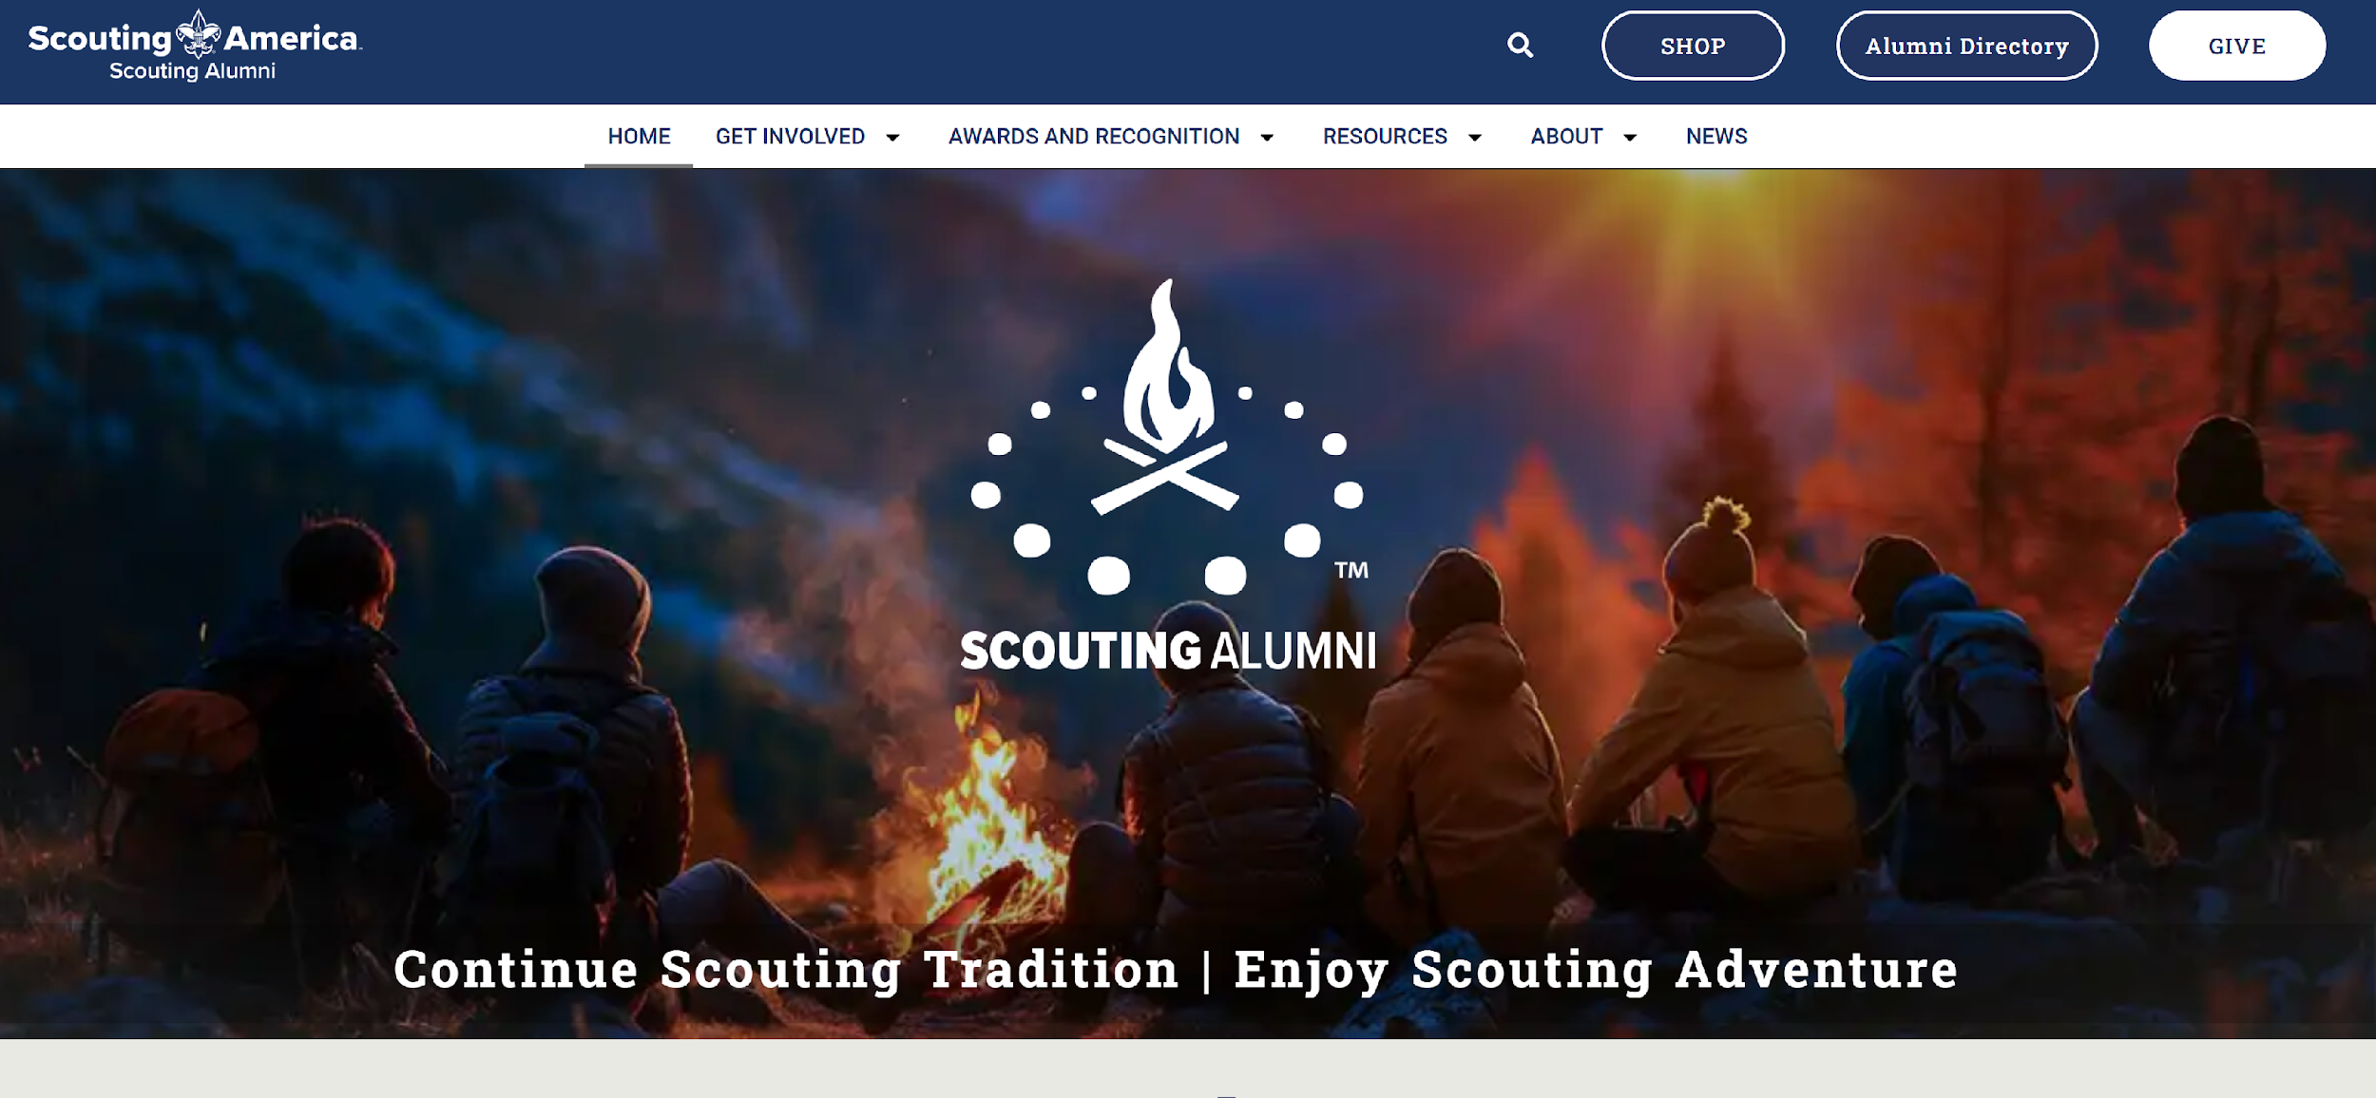
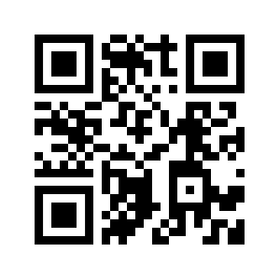
Scouting Alumni
Website

Slide 23
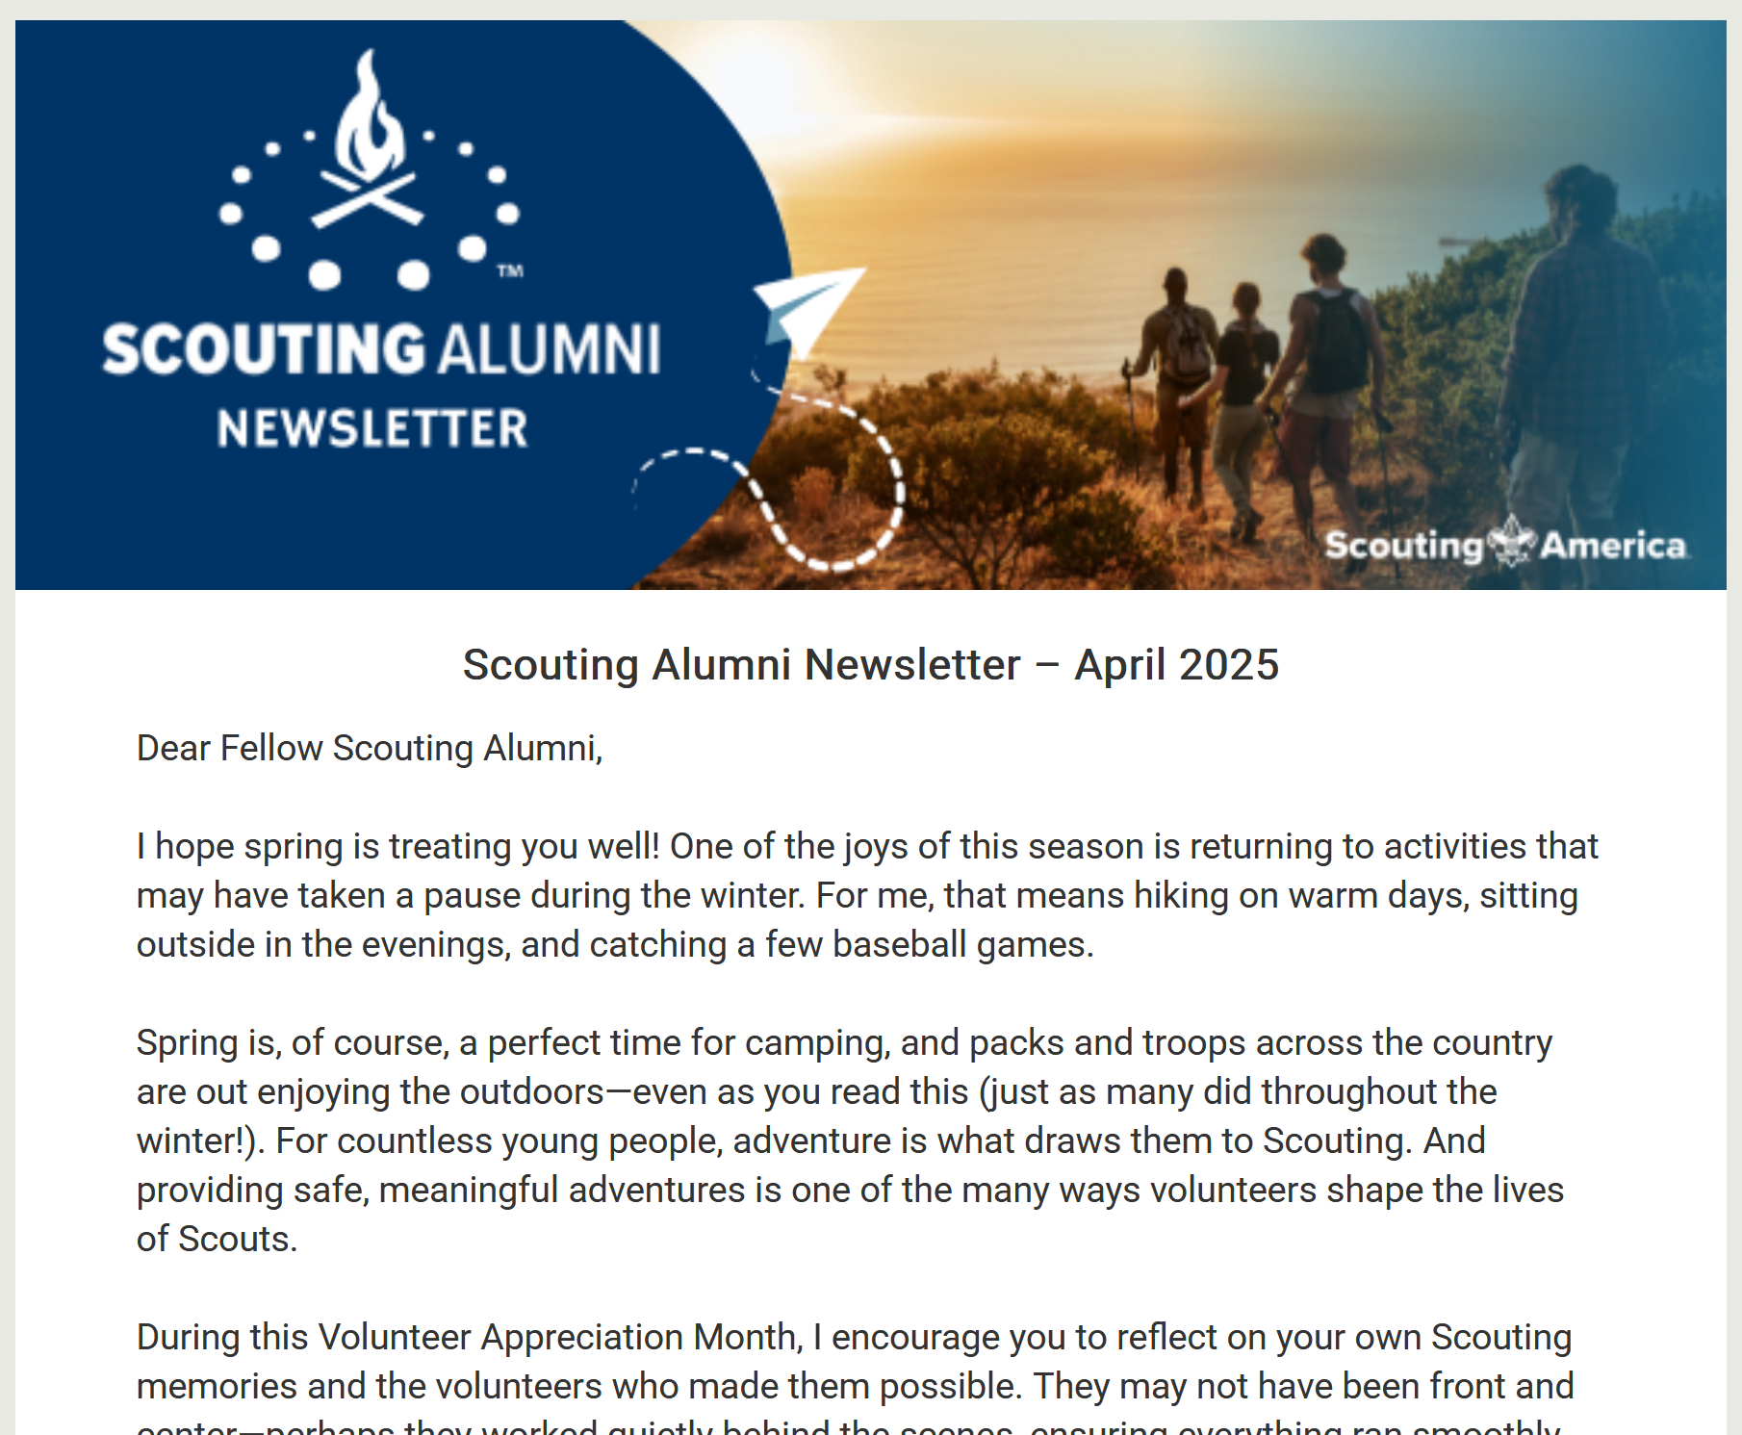
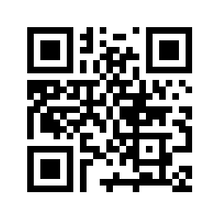
Scouting Alumni
Monthly e-Newsletter

Slide 24
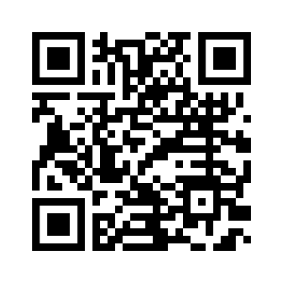
Scouting Alumni
Social Media Venues

Slide 25
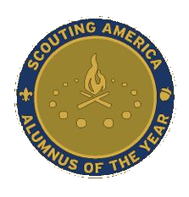
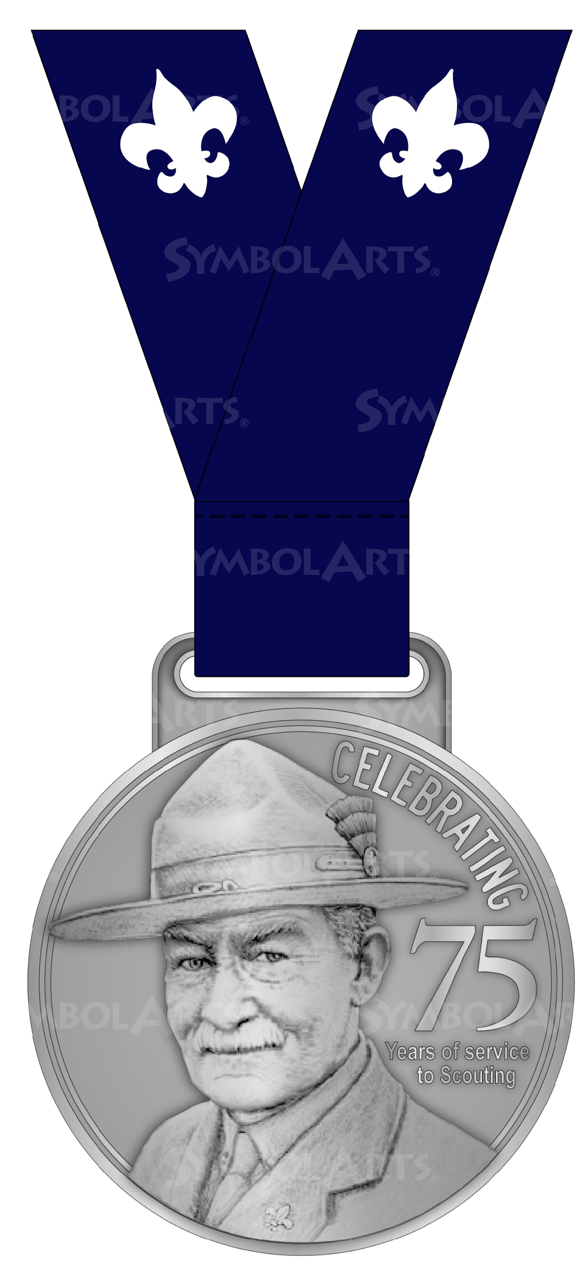
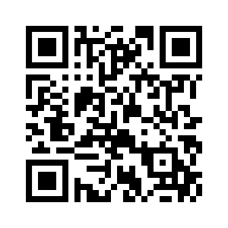
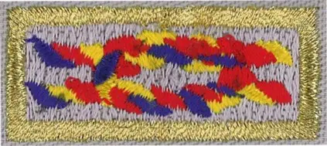
Scouting Alumni
Awards & Recognition

Slide 27
In Closing…
It’s a fact… Scouting grows stronger through alumni engagement.
Alumni are great for:
Advocates/Ambassadors
Volunteers
Donors
Youth Recruitment
Connections to Resources (access, business, and gift in kind)
Remember… The art of “Alumni Engagement” is simply the building of lasting relationships. Give them a call to action.
Notes:
Each of us has a role in nurturing and expanding our alumni community.

Slide 28
Your Call to Action… (As an Alumni Ambassador)
Assess the available alumni within your council regarding their shared interests and experiences
Create and develop local alumni groups that attract those available alumni
Celebrate their activities and successes
Highlight, promote, and share the interests, experiences, and legacies of your local Scouting Alumni
Notes:
Each of us has a role in nurturing and expanding our alumni community.

Slide 29
Thank You!
From Around the Campfire…
Bradley G. Taylor, National Lead
Alumni Communities Subcommittee
bgtaylor1991@gmail.com
(336) 408-8501
Timothy C. Brown, Vice Chair
Alumni Relations & Council Support
bsaalumnicommittee@gmail.com
(859) 421-5985

